Slide 1


CMSE 202 HONORS PROJECT- LOAN APPROVAL PREDICTION MODEL
ANUJ JADHAV

Slide 2

Introduction
Loans are critical for personal and economic growth, making the decision to approve or deny them are important for both banks and applicants
Current challenges include ensuring accuracy, fairness, and efficiency in loan decisions, influenced by subjective judgments and inconsistent criteria
The project objective of developing a predictive model for loan approval is highly relevant as it enhances decision accuracy, reduces operational costs, and increases efficiency, thereby enabling financial institutions to manage risk effectively while ensuring fair and transparent lending practices
Data-driven approaches can transform the loan approval process by providing deeper insights and predictive capabilities, minimizing human biases

Slide 3
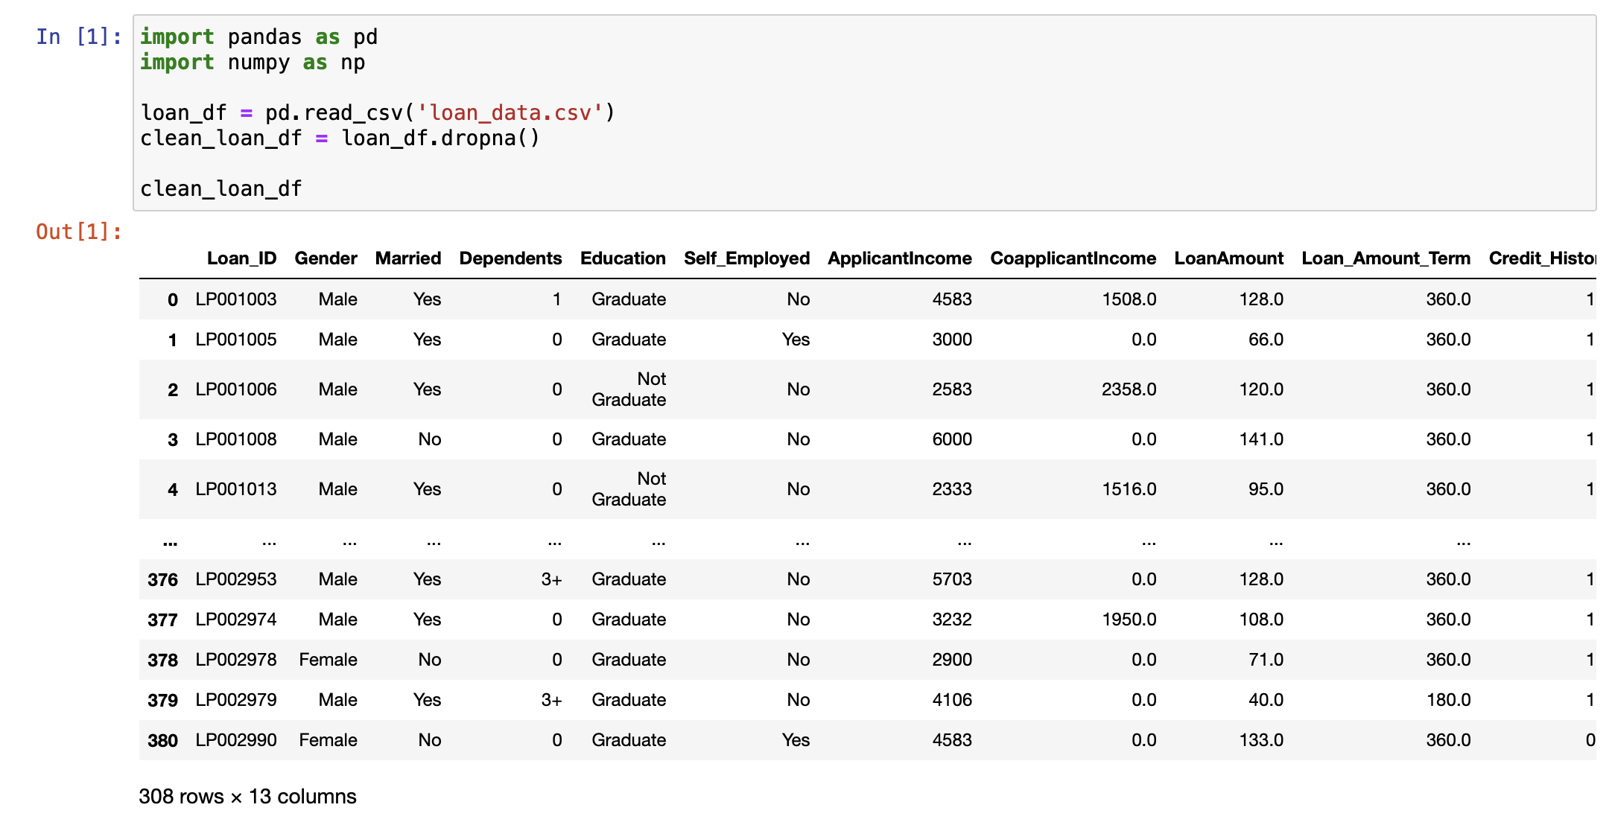
Overview of Data Used
Applicant Profiles: Includes demographics like gender and marital status
Financial Metrics: Details critical financial information, including loan amounts and repayment terms
Credit History: Features credit history to assess applicants' financial reliability and eligibility for loans
Socio-Economic Factors: Categorizes applicants by education, employment status, and residential area
Loan Approval: Tthe final loan approval decision, enabling the training of predictive models

Slide 4
Tools and Technologies used
Pandas
NumPy
Matplotlib
Seaborn
Scikit-Learn
Statsmodels
Utilized for data manipulation and analysis, for organizing and preparing the dataset for modeling
Used for creating interactive and visualizations to explore data trends and model outcomes
Introduction
Used for numerical operations, helping with calculations needed for data preprocessing
Used for making attractive and informative statistical graphics to better understand the data relationships
Applied for implementing machine learning algorithms, model training, and evaluation to predict loan approval outcomes
Used for statistical modeling, providing tools for the estimation of various statistical models and conducting statistical tests

Slide 5
Methodology Used
Simple Linear Regression
Multiple Regression
Logistic Regression
SVM Model
Used Credit History as a predictor to establish a baseline relationship with loan approval status
Expanded to include multiple factors like income and loan amount to capture their combined effects on loan approval
Used for its suitability in binary classification, predicting the probability of loan approval
Simple models serve as a baseline for evaluating the increasing value added by more complex methodologies in predicting loan approval outcomes

Slide 6
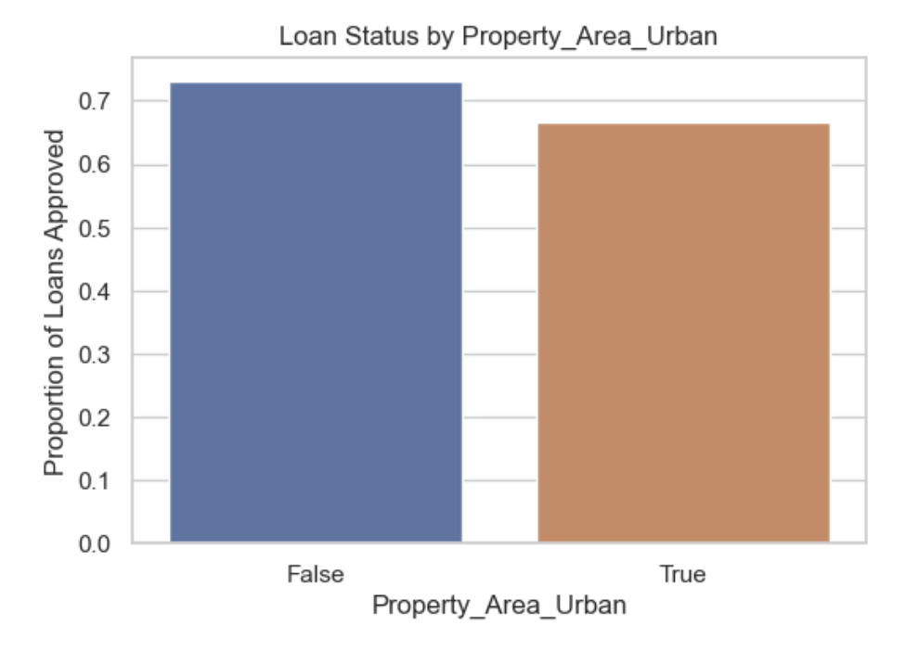
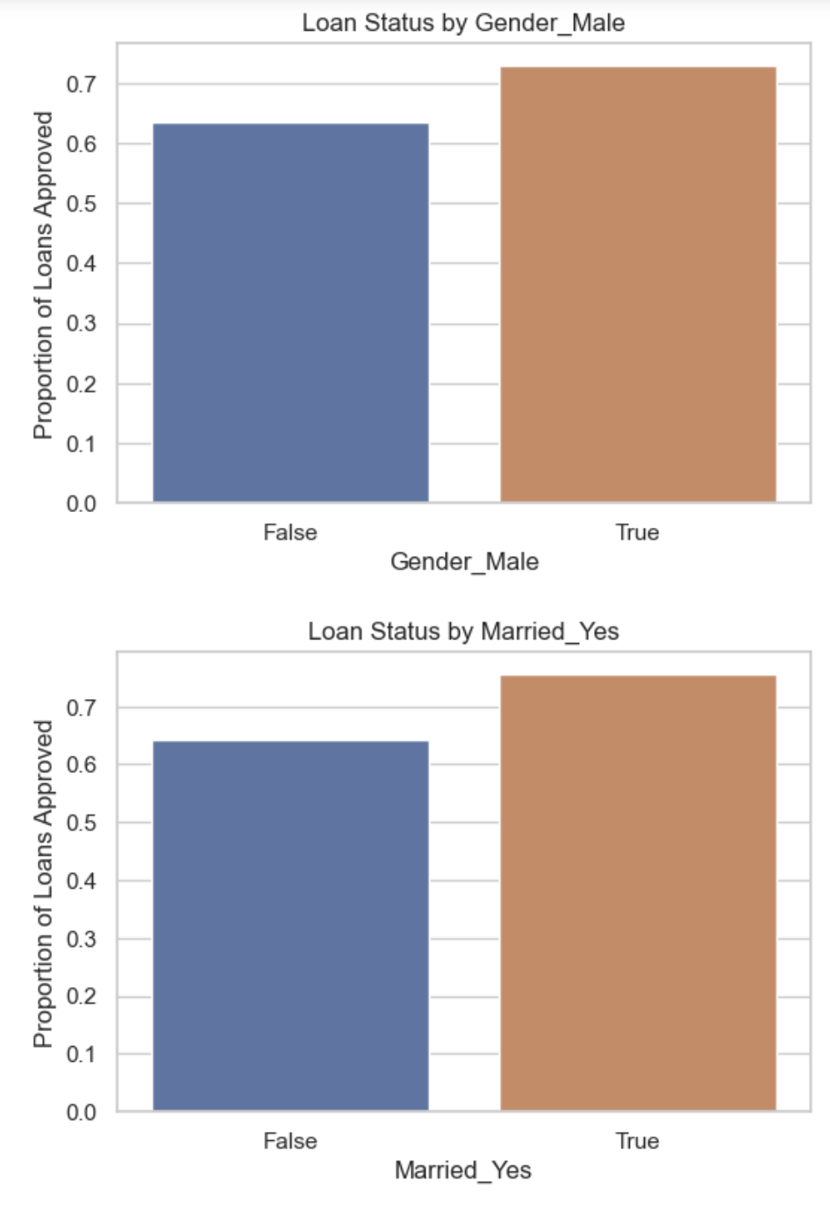
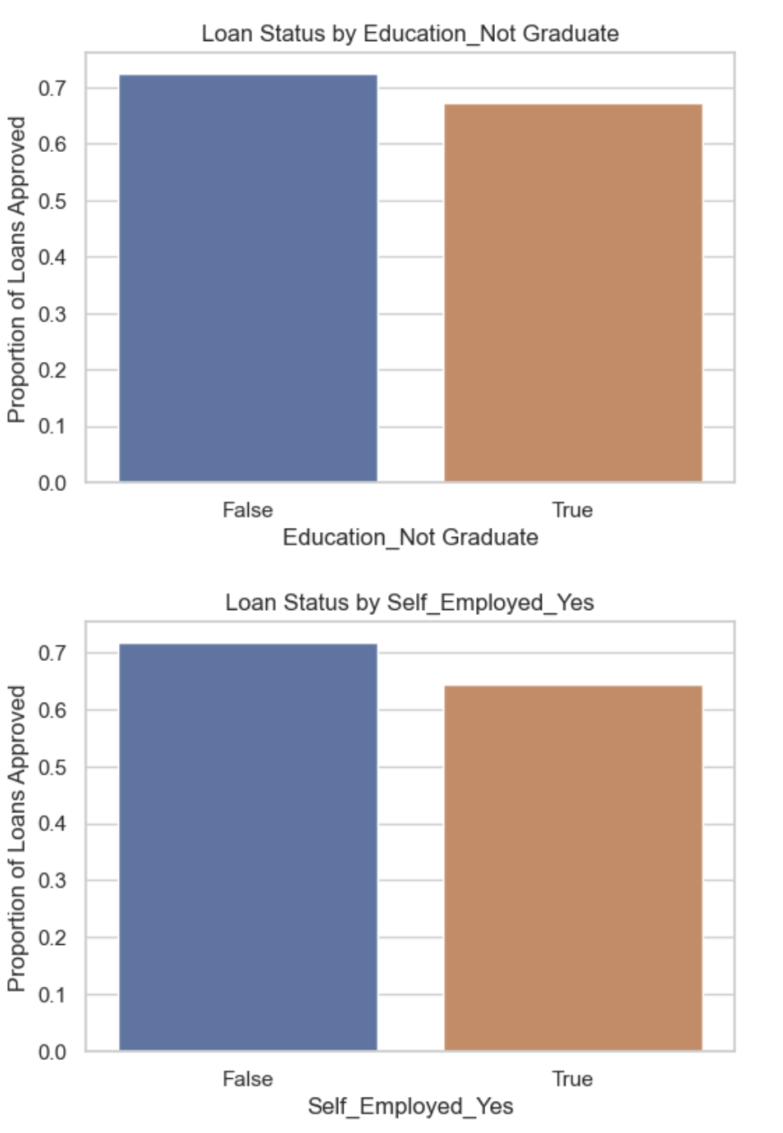
Initial Analysis
Gender Influence: Men have a slightly higher proportion of loan approvals compared to women
Marital Status Effect: Married applicants are more likely to have their loans approved than single applicants
Educational Impact: Graduates have a higher chance of loan approval compared to non-graduates
Employment Factor: Non-self-employed individuals tend to have a greater proportion of loan approvals
Property Area: Applicants from urban areas show a marginally lower loan approval rate compared to those from non-urban areas

Slide 7
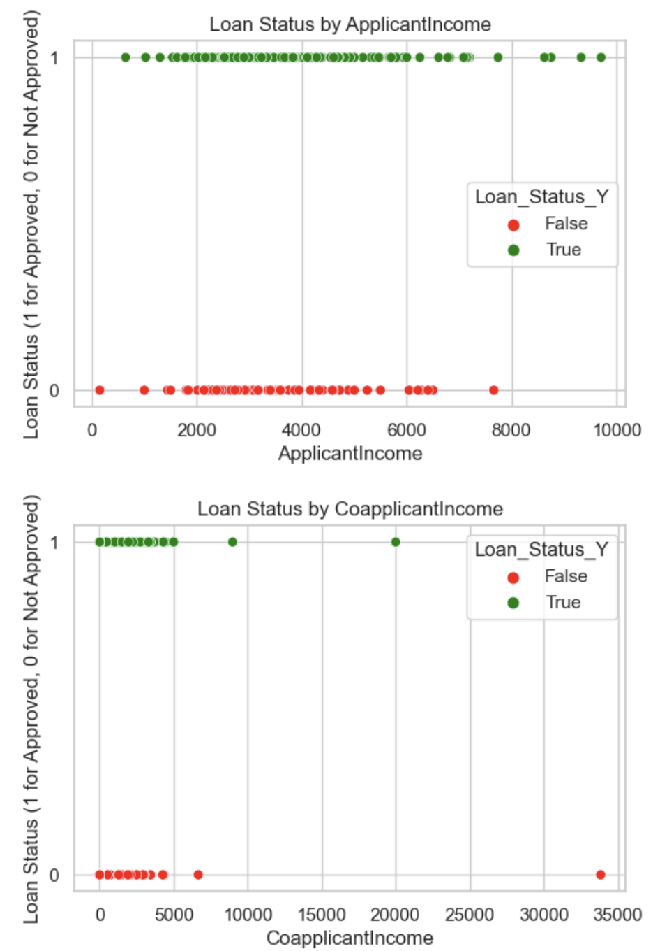
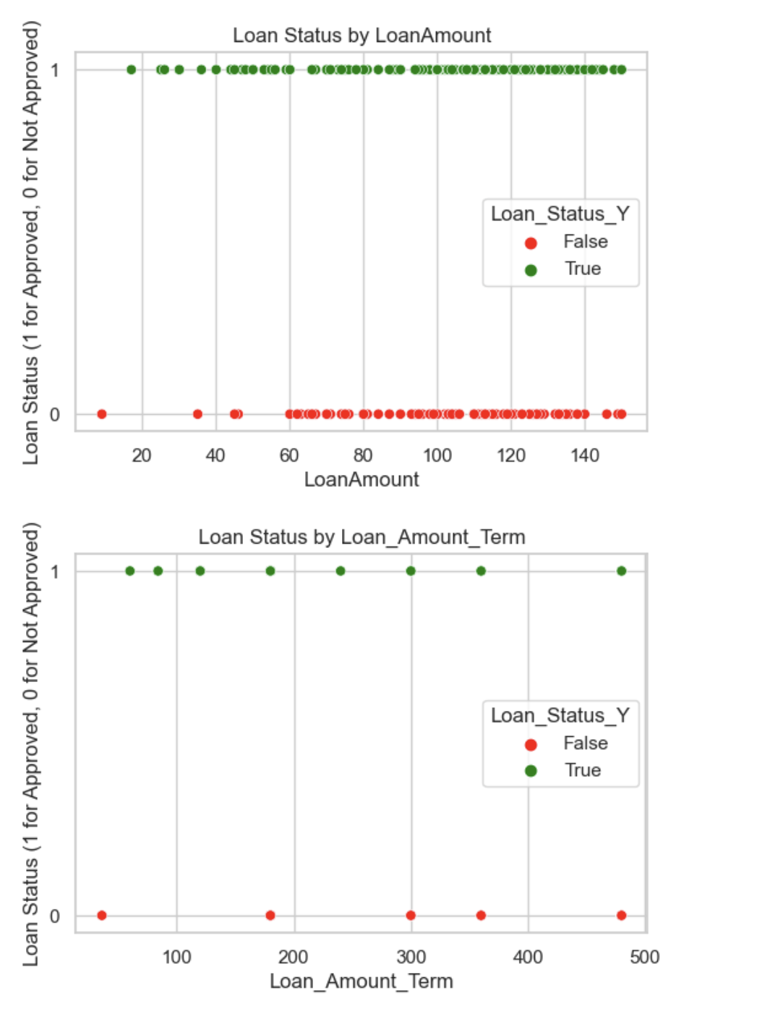
Initial Analysis
Applicant Income: No clear trend is observed between Applicant Income and loan approval, indicating income alone is not a decisive factor
Coapplicant Income: Similarly, Coapplicant Income does not show a distinct pattern with respect to loan approvals, suggesting other factors may play a more critical role
Loan Amount: Loan approvals appear to be evenly distributed across different Loan Amounts, without a direct correlation to approval rates
Loan Amount Term: The term of the loan does not display a significant impact on loan approval status, with approvals appearing across various term lengths

Slide 8
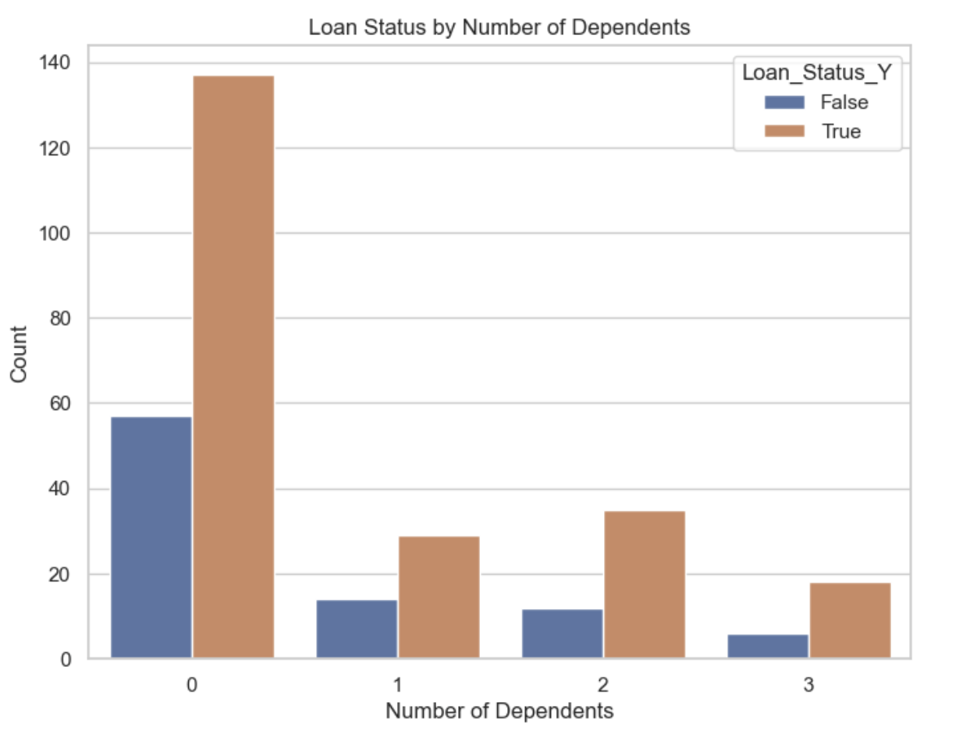
Initial Analysis
Influence of Dependents on Loan Approval:
Applicants with no dependents have the highest number of loan approvals, suggesting financial obligations towards dependents might impact the likelihood of approval
The approval count decreases as the number of dependents increases, with a notable drop for applicants with three dependents, indicating a potential correlation between the number of dependents and loan approval rates

Slide 9
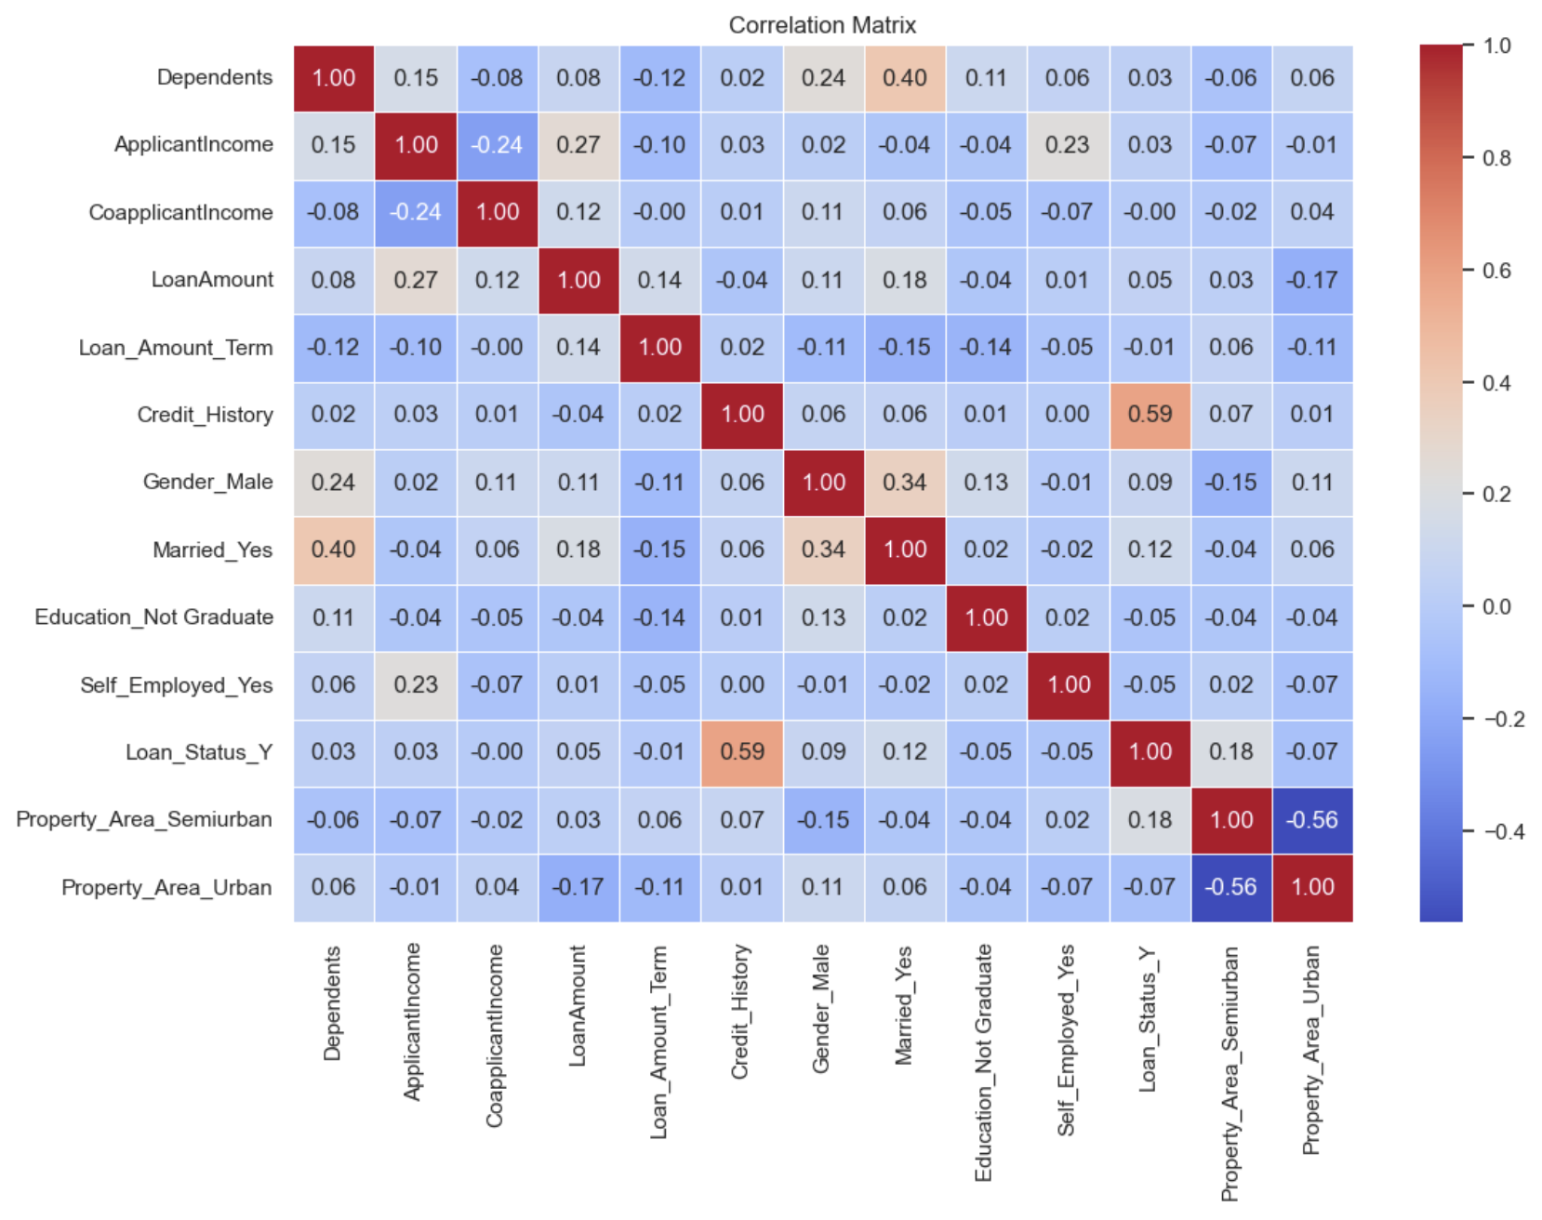
Correlation Matrix
Credit History Influence: Shows a strong positive correlation with Loan Status, suggesting it's a significant predictor for loan approval
Marital Status Link: Married individuals have a moderate positive correlation with Loan Status, hinting at a potential preference for approving loans to married applicants
Income Correlation: Both ApplicantIncome and CoapplicantIncome show low to negligible correlations with Loan Status, indicating that income alone may not be a strong predictor of loan approval
Property Area Dynamics: Semiurban property ownership is moderately positively correlated with Loan Status, whereas urban property ownership has a slight negative correlation
Debt and Duration: Loan Amount and Loan_Amount_Term have very low correlations with Loan Status, suggesting loan size and repayment term are less critical in determining approval outcomes

Slide 10
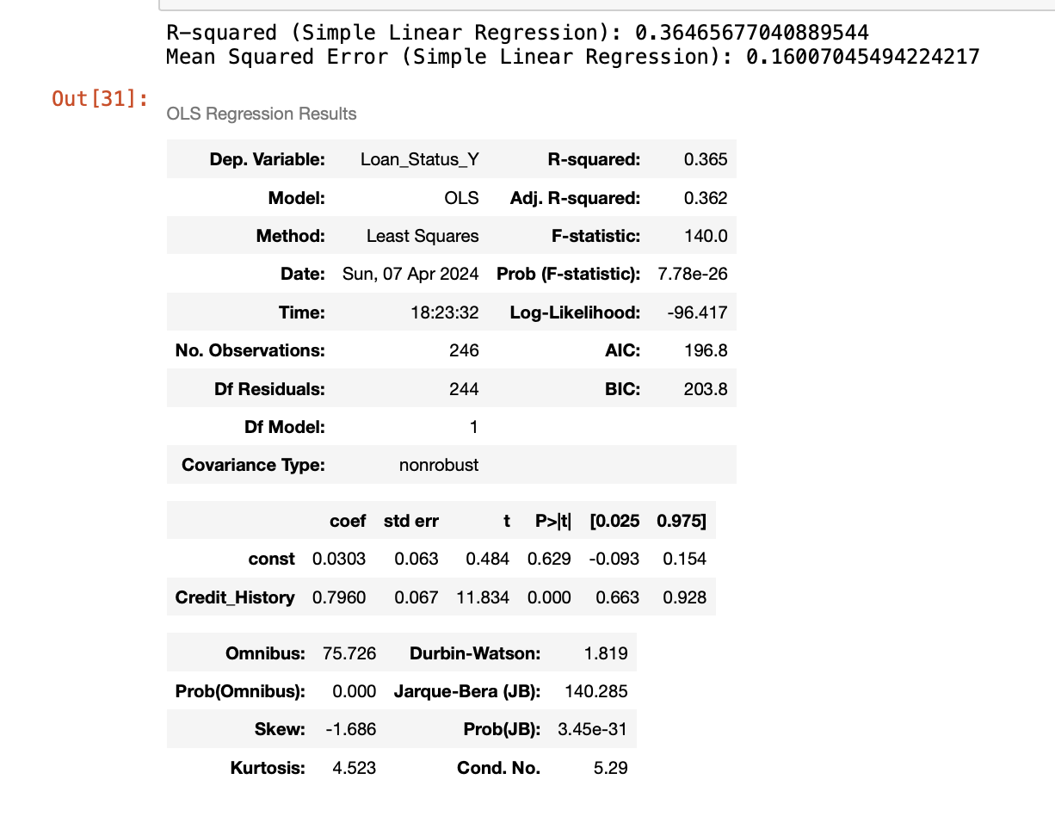
Simple Linear Regression
Credit History as a Predictor: The simple linear regression model with Credit History as the predictor accounts for approximately 36.5% of the variance in Loan Status (R-squared: 0.365)
Model Significance: The F-statistic and its associated p-value indicate that the model is statistically significant, suggesting Credit History is a meaningful predictor of Loan Status
Coefficient Interpretation: The positive coefficient for Credit History (0.796) implies a strong positive effect on loan approval chances, the better the credit history, the higher the likelihood of loan approval
Model Accuracy: A Mean Squared Error (MSE) of 0.160 suggests that the model's predictions are reasonably close to the actual values, with some room for improvement

Slide 11
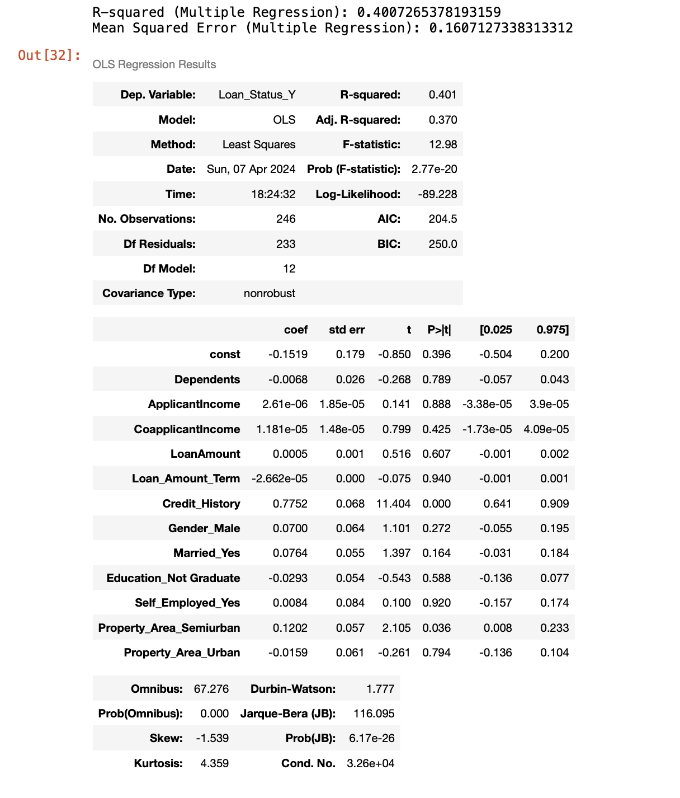
Multiple Linear Regression
Enhanced Model Complexity: The multiple regression model, incorporating a broader range of variables, explains 40.07% of the variance in loan approval status (R-squared: 0.401
The model shows relationship with certain predictors showing a stronger relationship with loan approval outcomes
Predictive Power of Credit History: Credit History remains a strong predictor in the multiple regression model, affirming its importance in the loan approval process
Model Precision: With a Mean Squared Error (MSE) of approximately 0.161, the model's predictions have room for improvement but still provide valuable insights for loan approval predictions

Slide 12
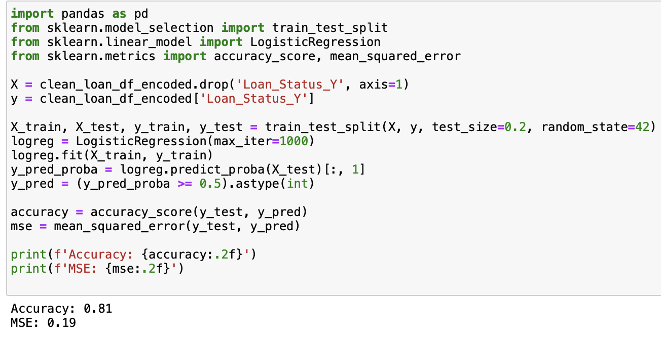
Logistic Regression Model
High Accuracy: The logistic regression model achieved a strong accuracy of 81% on the test set, indicating a high level of precision in predicting loan approval status
MSE: A Mean Squared Error (MSE) of 0.19 shows the model's prediction error, reflecting the variance between the predicted and actual values
Model Suitability: The accuracy score confirms the logistic regression model is well-suited for the binary classification task of predicting loan approvals
Predictive Reliability: The results suggest that the model can reliably assist in decision-making, accurately identifying the likelihood of loan approval in most cases

Slide 13
SVM Model
SVM Performance: The SVM classifier achieved a high accuracy rate of 81% in classifying loan approvals, comparable to the logistic regression model
Precision and Recall: Precision for the positive class (loan approved) is high at 80%, with a recall of 95%, indicating the model is particularly effective at identifying true positives
F1-Score : The F1-score, which combines precision and recall into a single metric, stands at 0.87 for approved loans, indicating a strong overall performance of the model for this class
Classifier Effectiveness: Given the similar performance metrics to the logistic regression model, the SVM classifier proves to be a good alternative for predicting loan approval status

Slide 14
Results
Simple Linear Regression
Multiple Regression
Logistic Regression
SVM Classifier Model
Showed moderate effectiveness, achieving an R-squared of 0.365, indicating that approximately 36.5% of the variability in loan approval is explained by the model, specifically using credit history as a predictor
Showed a slight improvement in explanatory power with an R-squared of 0.401, suggesting that combining multiple factors like income, loan amount, and marital status provides a better fit for predicting loan approvals
Demonstrated strong predictive accuracy with a score of 0.81, effectively categorizing loan approval outcomes and confirming its suitability for binary classification tasks in this context
Showed strong predictive accuracy with a score of 0.81, effectively categorizing loan approval outcomes and confirming its suitability for binary classification tasks in this context

Slide 15
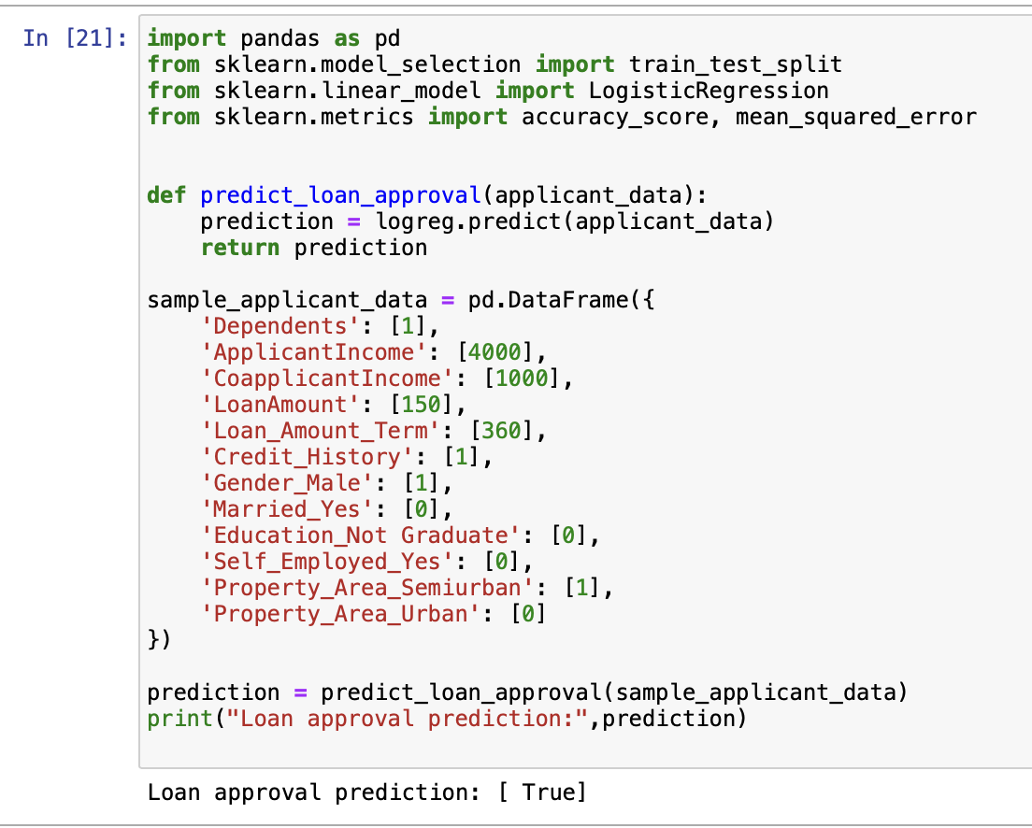
Application
Functionality of Prediction Model: Used the trained logistic regression model to predict loan approval based on individual applicant data
Sample Data Used: A hypothetical applicant with specific attributes such as a single dependent, an income of $4,000, and a co-applicant income of $1,000, among other features
The model processes the applicant's data and outputs a prediction, indicating whether the loan is likely to be approved or not
Outcome : For the sample applicant provided, the model predicts loan approval, demonstrating the model's application in real-world decision-making
The model's capability to assist financial institutions in making informed, data-driven loan approval decisions quickly and efficiently

Slide 16
References
Dataset:
https://www.kaggle.com/datasets/bhavikjikadara/loan-status-prediction/data

